Slide 1
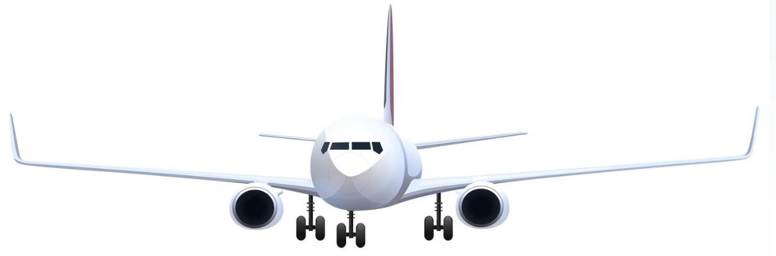
Turkish Airline Safety Analysis Executive Summary
Anthony LaRosa

Slide 2
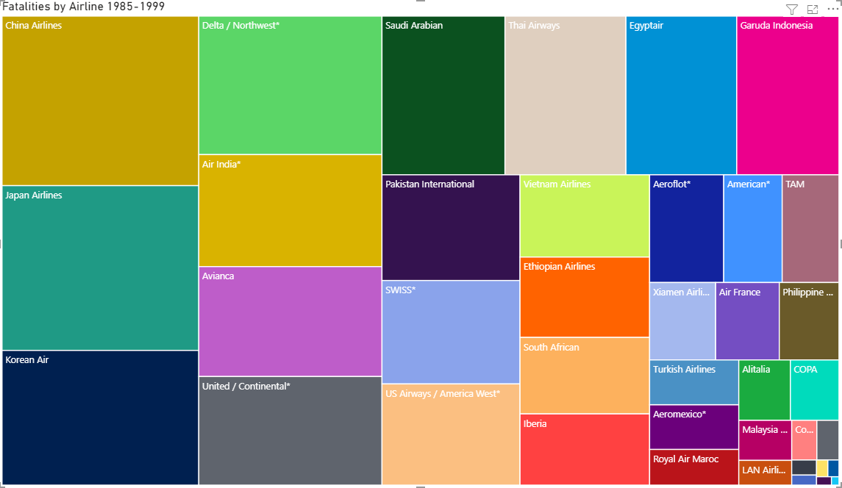
Fatalities 1985-1999
Below it can be seen that airline travel as a whole, and especially Turkish Airlines has demonstrated a high degree of safety.

Slide 3
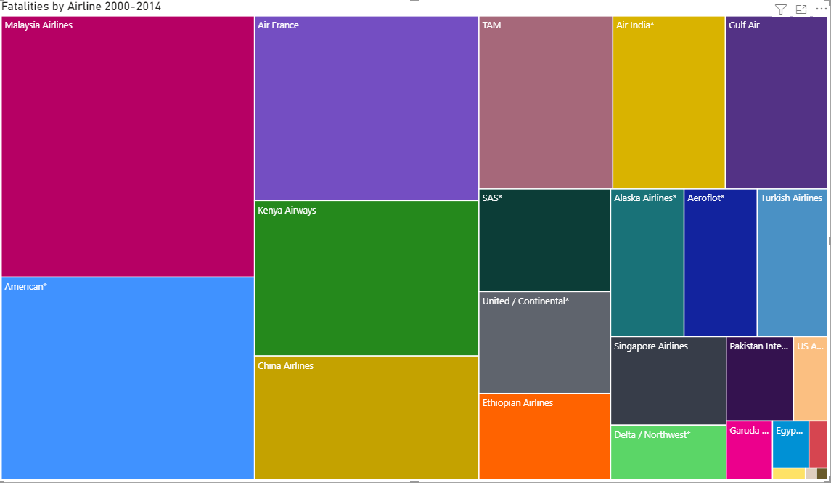
Fatalities 2000-2014
Below it can be seen not only was it a safe form of travel previously, but is increasing in its safety over time

Slide 4
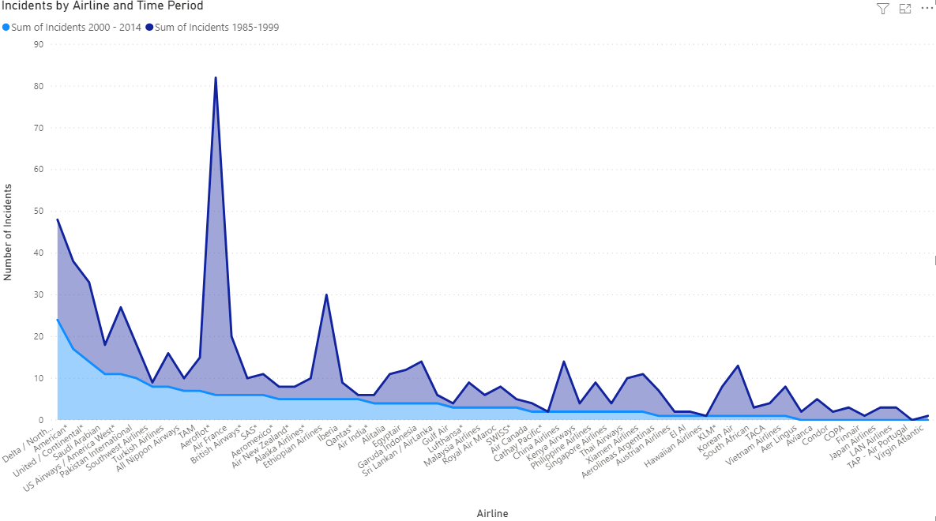
Incidents by Airline and Time Period
Transforming the data we can visualize the discussion from the previous slides to clearly see that the fatalities have been reduced and airlines are becoming more safe

Slide 5
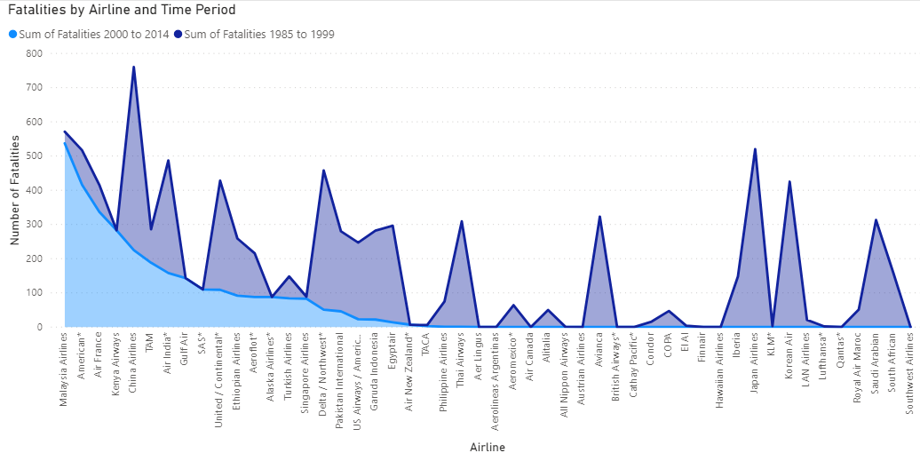
Fatalities by Airline and Time Period
It can be seen that the fatalities follow a similar trend as the incidents and the Airlines have a remarkable level of safety

Slide 6
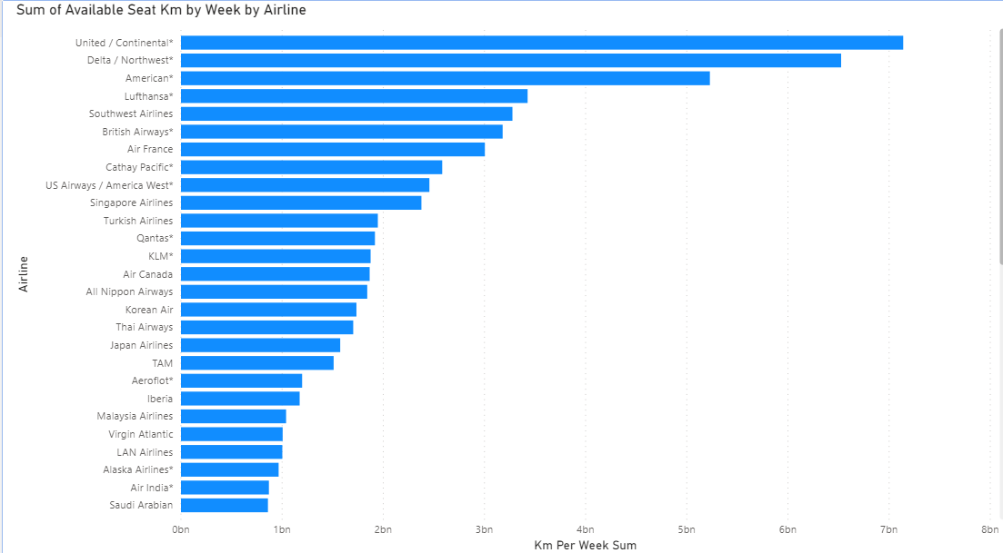
Sum of Available Seat Km by Airline
Below it can be seen that Turkish Airlines has a high-level of safety while having seats filled. Turkish Airlines does not have an excessive amount of open seat kilometers

Slide 7
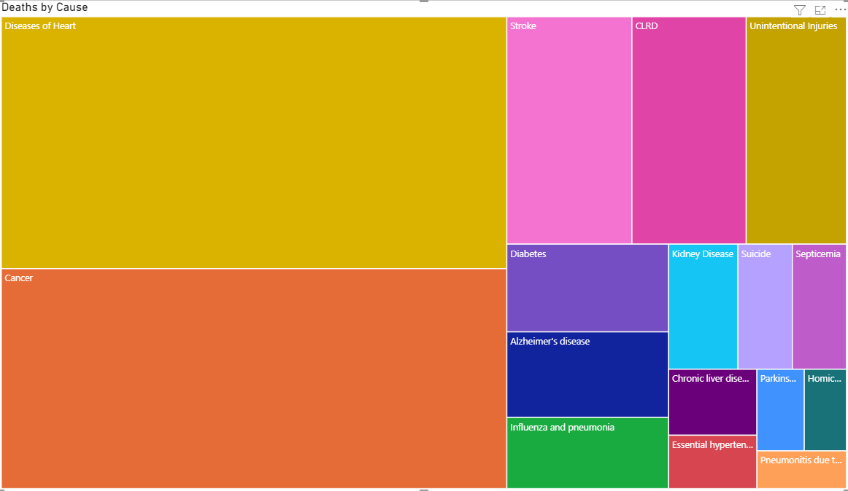
Leading Cause of Death 1999 - 2013
If we review the leading cause of death from 1999-2013, it can be seen that there are far more likely causes of fatality than airline transportation.

